Slide 1

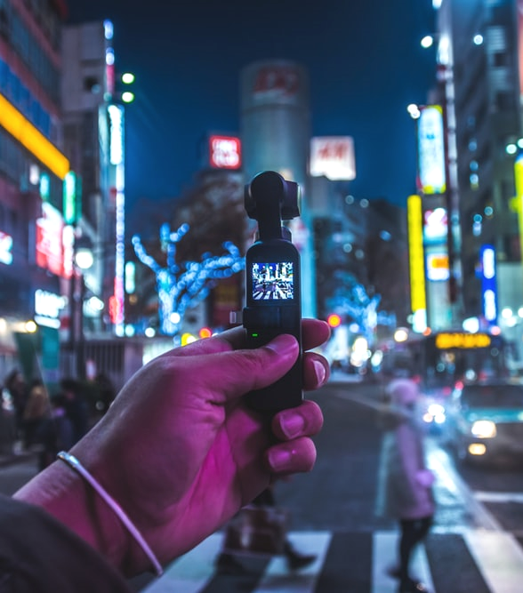

Live Class
Via Zoom
Chapter III.
“Vancity”

Slide 2



Index / Índice. “Vancity”
1
Introduction
6
Directions with Imperatives
2
Warm-up: About me
7
How to arrive?
3
Listening: Places in the City
8
Dialogue: Lost in the CIty
4
Prepostions of Place
9
Game: Bingo
5
Locate of Place
10
What have I learnt today? …
Book II: Linda in Real Life
Centro de Idiomas 2019

Slide 3
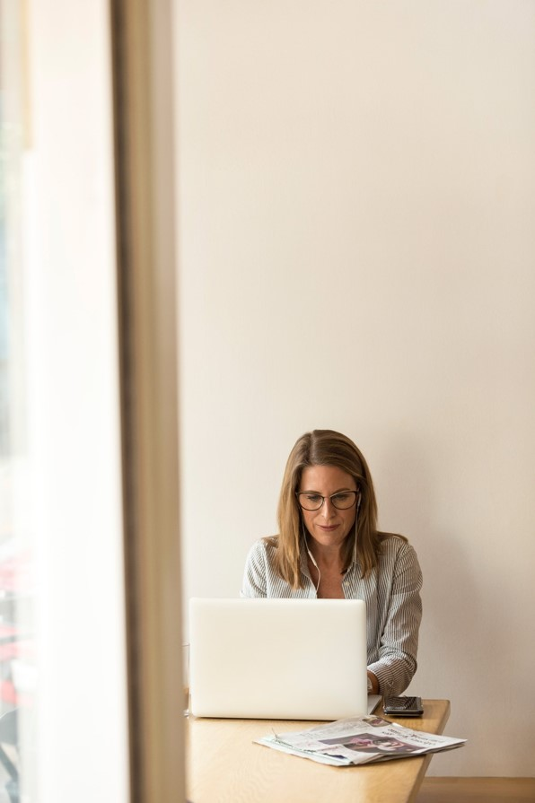
Part I. Introduction
Welcome to this live videoconference class!
In this final part of the chapter, you’ll put into practice everything you’ve learnt in the previous steps through dialogues, monologues, group discussion, games and other fun exercises.
The class is an important moment through which you can interact with your teacher and classmates in the contextualized situations from your virtual journey to learn English aboard.
Good luck!
¡Bienvenido / Bienvenida a esta clase por videoconferencia en vivo!
En esta parte final del capítulo, pondrás en práctica todo lo que has aprendido en los pasos previos a través de diálogos, monólogos, grupos de discusión, juegos y otros ejercicios divertidos.
La clase es un momento importante a través del cual puedes interactuar con tu maestro y compañeros en las situaciones contextualizadas de tu viaje virtual para aprender inglés en el extranjero.
¡Buena suerte!
Book II: Linda in Real Life
Centro de Idiomas 2019

Slide 4
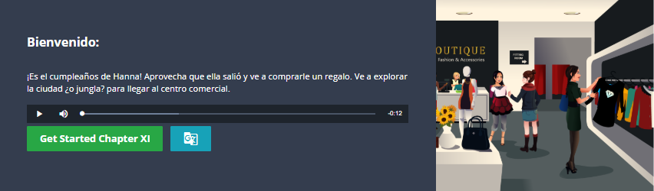
Part I. Class Objective
By the end of the class, you will be able to talk about places in the city; asking and giving directions. For this objective, you’ll also practice prepositions of place, use common structures relating to directions and review the use of ‘there+to be’.
Al final de esta clase, serás capaz de hablar sobre lugares de la ciudad; pedir y dar direcciones. Para esta finalidad, también practicarás preposiciones de lugar, usarás estructuras relacionadas con direcciones y repasarás el uso de "there + to be".
Book II: Linda in Real Life
Centro de Idiomas 2019

Slide 5
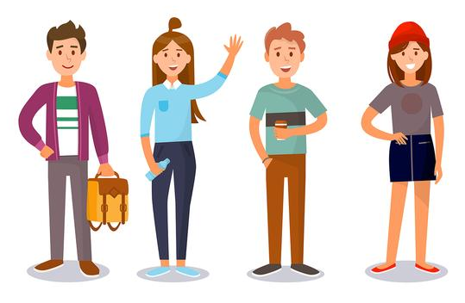
Part II. Warm-up Activity
Instructions: The teacher and students will give information about themselves using the questions below. After that, the teacher will return to each student and see how much information you remember about your classmates.
Questions:
Where do
you live?
- B.A. (Degree)
- Favorite subject
- Favorite book
- Favorite movie
- Favorite place
- Favorite hobby
Answers:
I live in Mexico City.
- …..
- …..
- …..
- …..
- …..
- …..
David lives in Mexico City, he likes the countryside & camping.
Book II: Linda in Real Life
Centro de Idiomas 2019

Slide 6
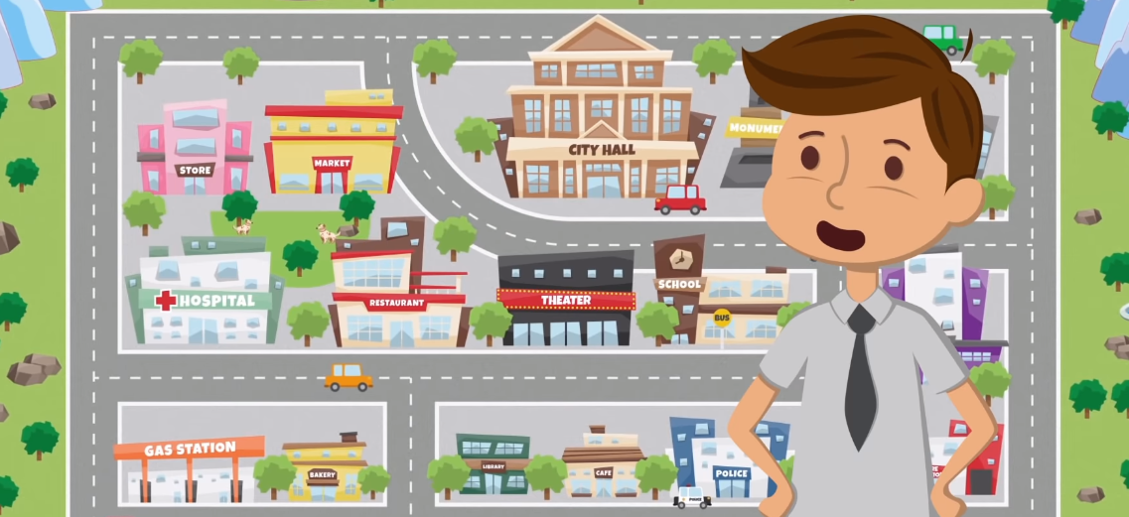
Part III. Places in the City
Instructions: ….Watch the animated tour of the city and answer this question:
At the end, how does the speaker describe the tour of the city?
Little Smart Planet: https://www.youtube.com/watch?v=UdDXlL9u0vI
Book II: Linda in Real Life
Centro de Idiomas 2019

Slide 7
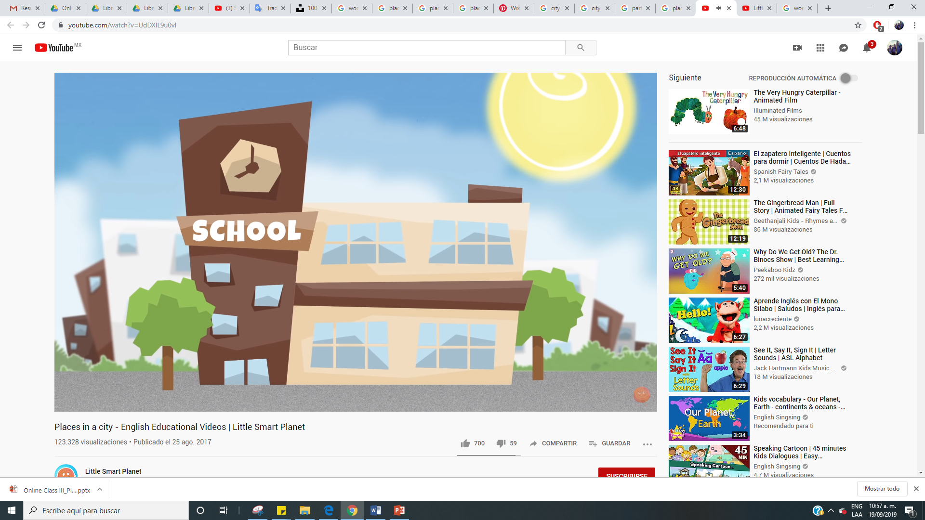
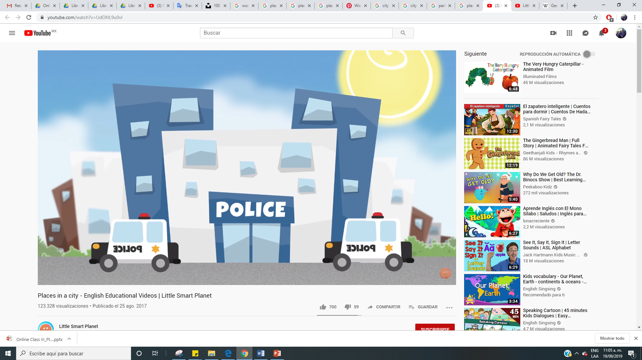
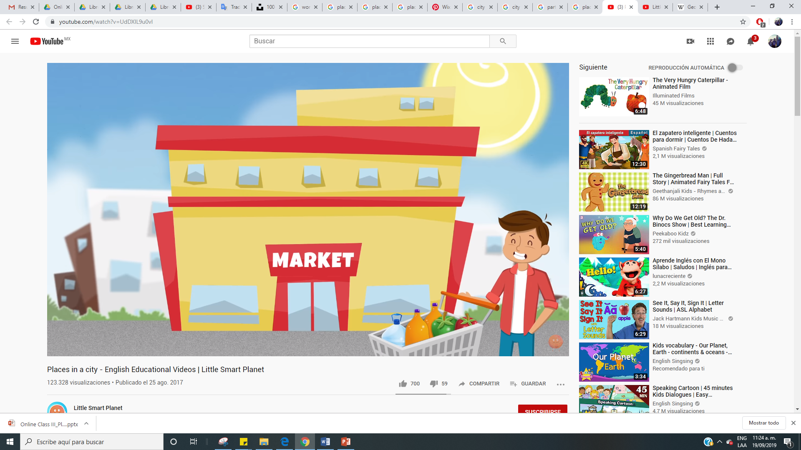
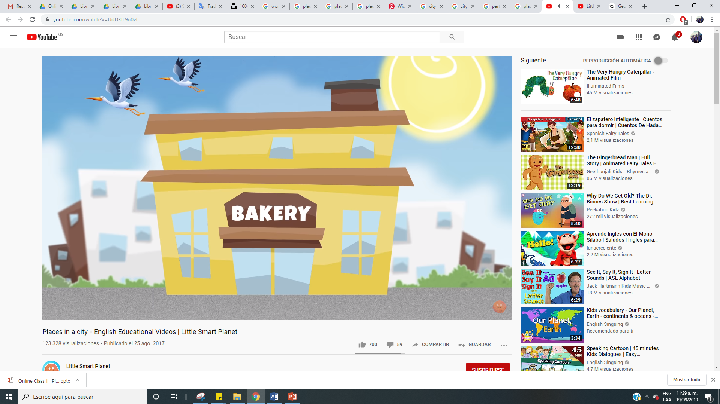
Part III. Places in the City
1. Where do children go at break-time? 2. Who works at the Police Station?
3. What do you use at the supermarket? 4. What foods does the baker prepare?
Book II: Linda in Real Life
Centro de Idiomas 2019

Slide 8
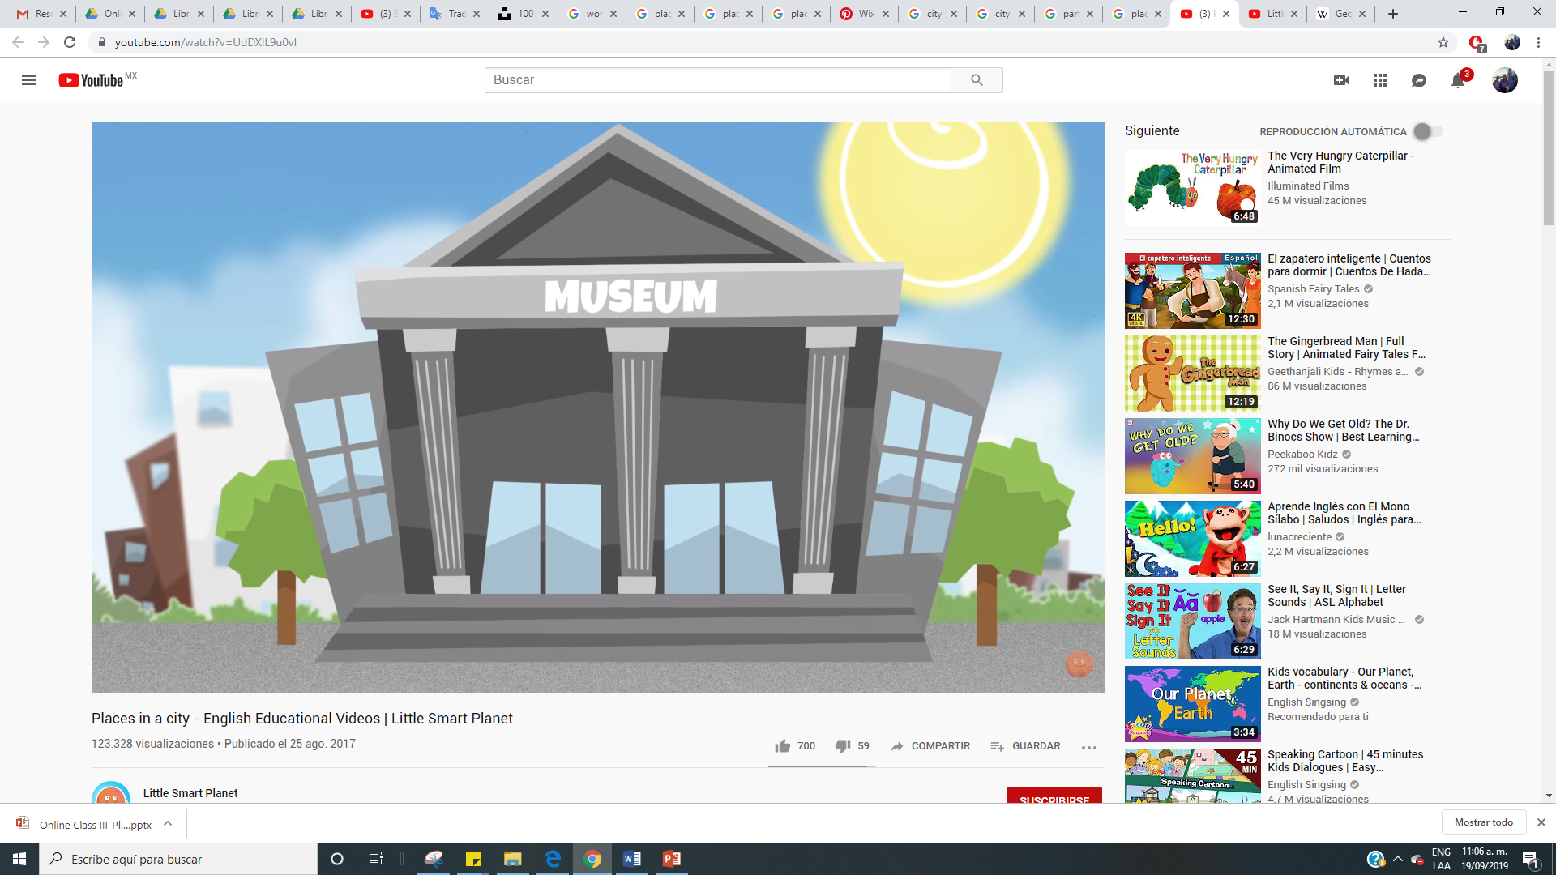
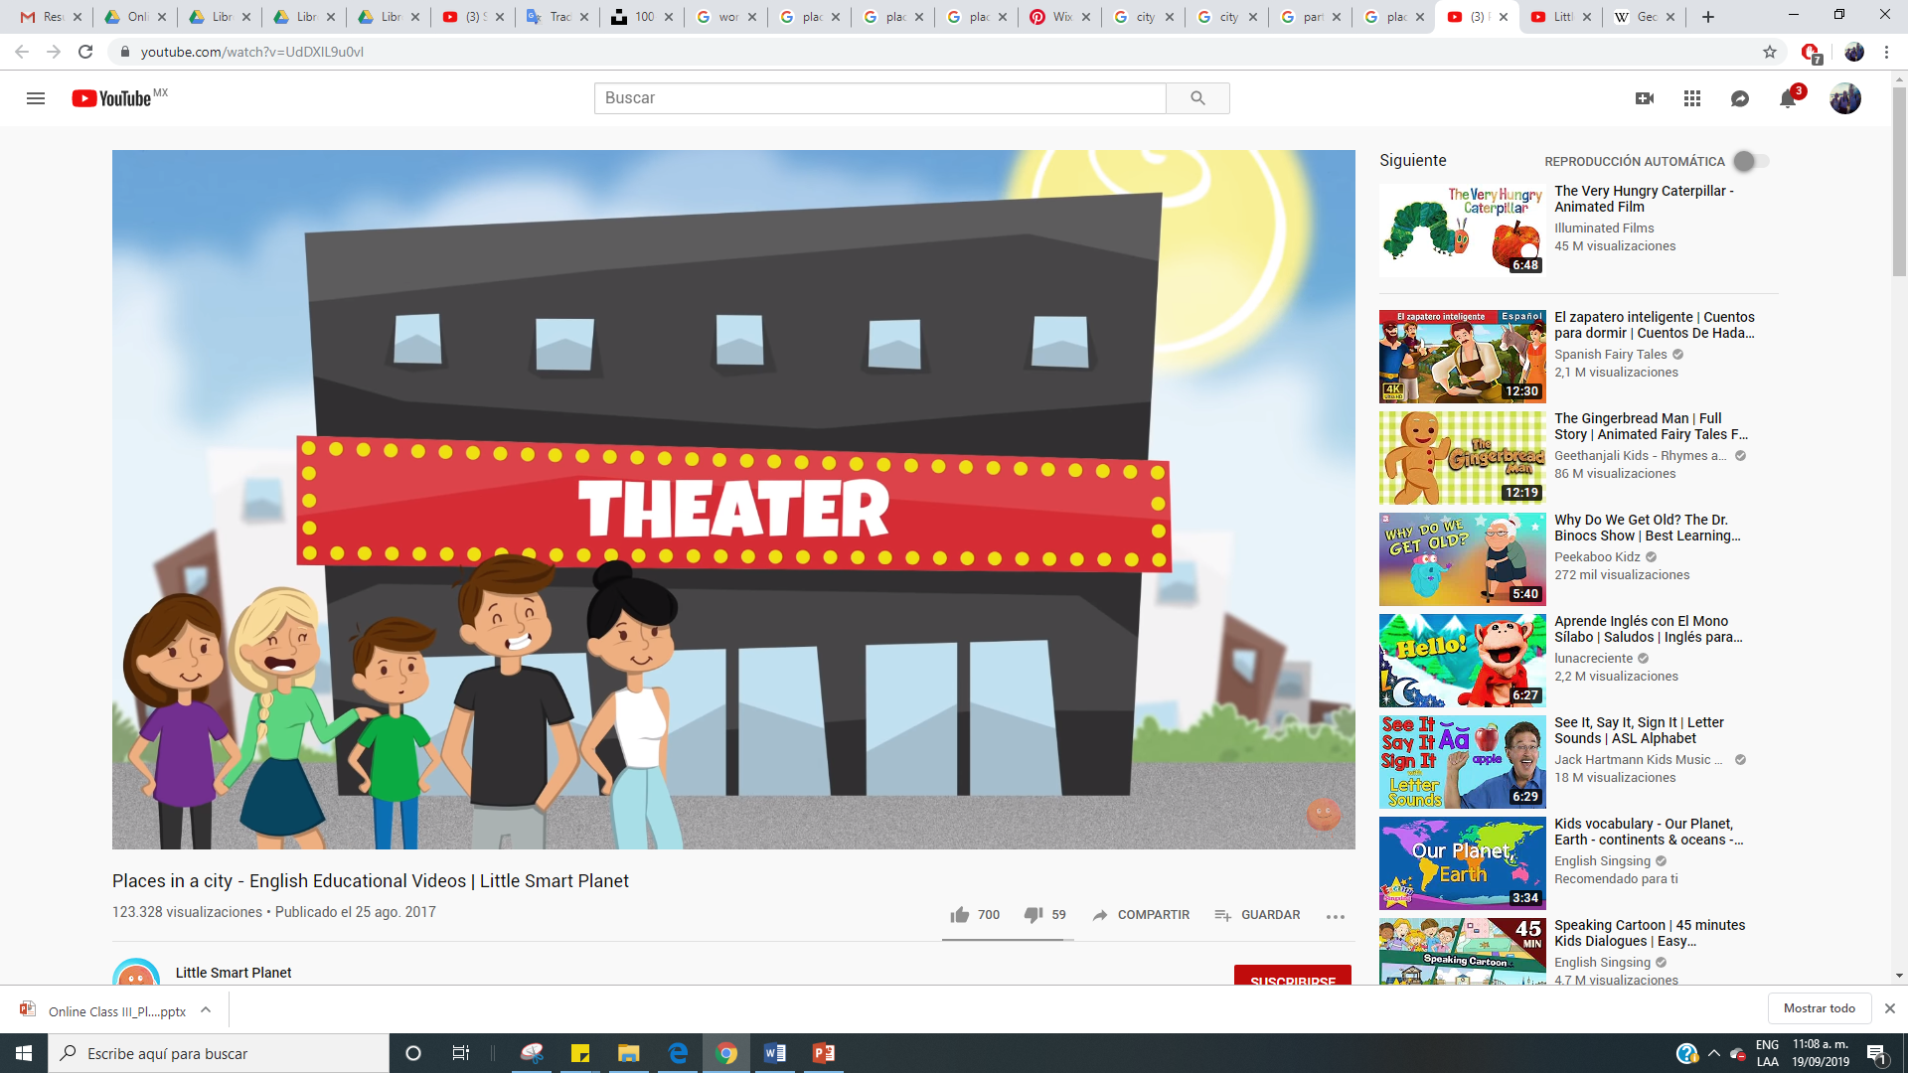
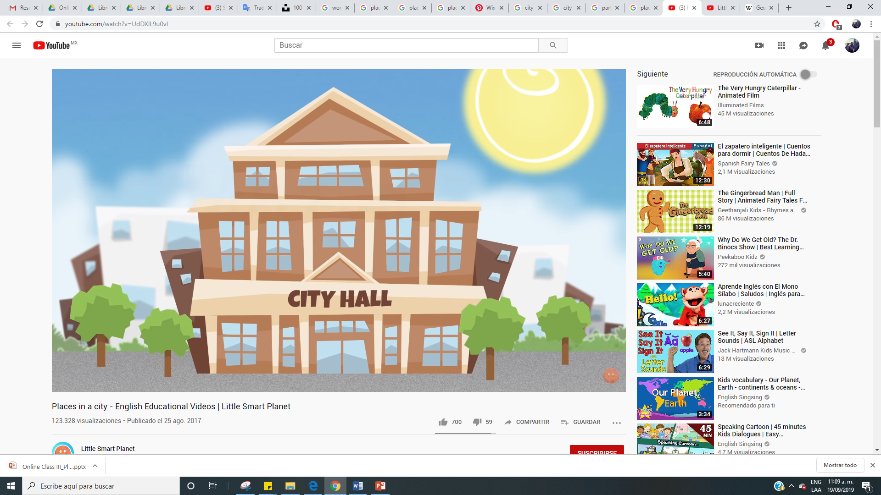
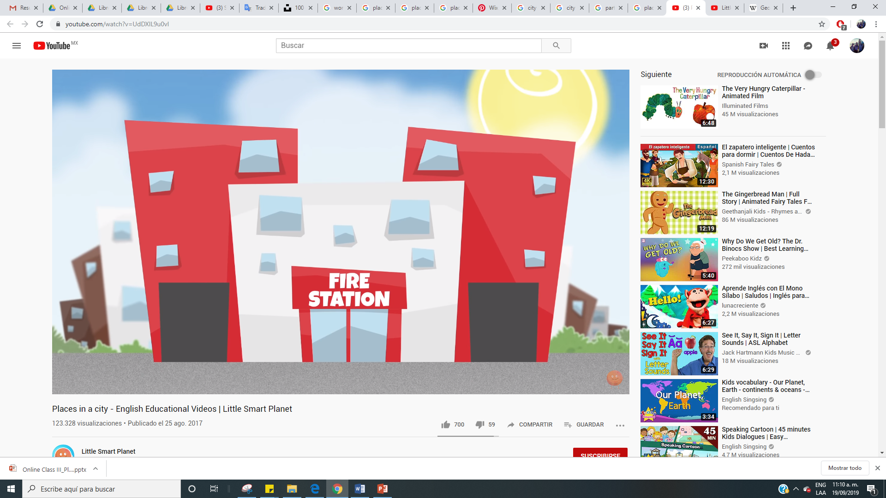
Part III. Places in the City
5. Which objects are in the museum? 6. What is there tonight at the theatre?
7. Who works at the City Hall? 8. Why do fireman go to their station?
Book II: Linda in Real Life
Centro de Idiomas 2019

Slide 9
Part III. Places in the City
1. The children go to the playground. 2. Policemen work in the Police Station.
3. You use a shopping cart for groceries. 4. The baker cooks bread and cakes.
Book II: Linda in Real Life
Centro de Idiomas 2019

Slide 10
Part III. Places in the City
5. There are paintings and art pieces. 6. There is a great play at the theatre.
7. The Mayor works at the City Hall. 8. They go to the Fire Station to rest.
Book II: Linda in Real Life
Centro de Idiomas 2019

Slide 11
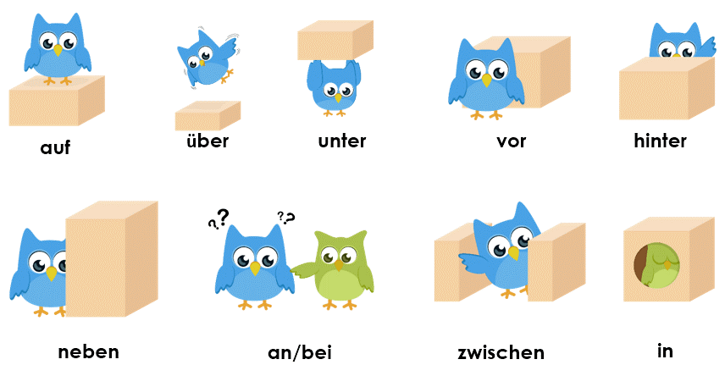
Part IV. Prepostions of Place
Instructions: Do you remember the prepostions of place? Let’s review them …
Book II: Linda in Real Life
Centro de Idiomas 2019

Slide 12
Part IV. Prepostions of Place
Now make sentences: 1. Where is the bird? 2. The bird is on the box.
on above under/below in front of behind
next to close to / near between in
Book II: Linda in Real Life
Centro de Idiomas 2019

Slide 13
Part V. Locate the Places
Instructions: Look at the map of the city and locate the places with prepositions.
There is a restaurant below the market and next to the hospital .
Book II: Linda in Real Life
Centro de Idiomas 2019

Slide 14
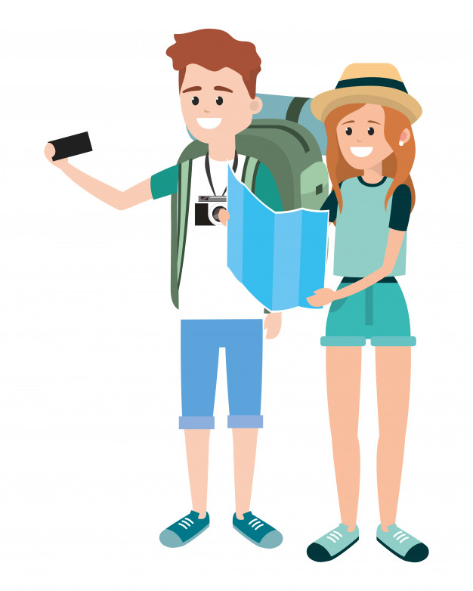
Part VI. Directions with Imperatives
We use the imperative form to give orders or directions in English.
“Eat your vegetables!”
“Turn left and go straight on .”
We can also use the imperative form to give a warning or advice, and (if you use “please”) to make a request.
“Practise English for ten minutes a day!”
“Be careful!”
“Please take a seat.”
Book II: Linda in Real Life
Centro de Idiomas 2019

Slide 15
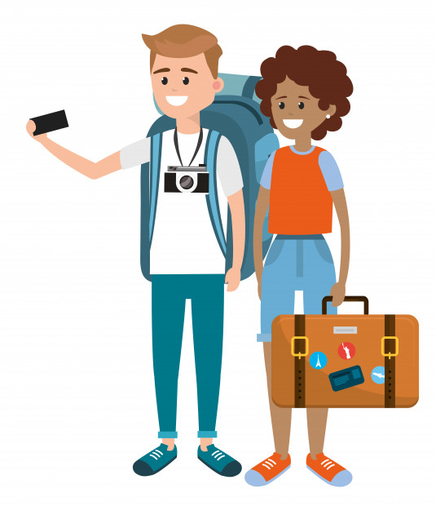
Part VI. Directions with Imperatives
To make a negative imperative, put “do not” or “don’t” before the verb. (Don’t is more informal than “do not”.)
“Don’t leave now!”
“Do not walk on the grass.”
As with the affirmative imperative, you can use “please” to make a more polite request.
“Please don’t run inside!”
“Please don’t worry!”
“Don’t arrive late, please .”
Book II: Linda in Real Life
Centro de Idiomas 2019

Slide 16
Part VI. Directions with Imperatives
Use “Where is...?” and “How” to ask about the location of things and to get guidance.
Where is the stadium?
How do I get to the stadium?
For the answer, we use the imperative and prepositions of place and word like ‘left’, ‘right’, ‘straight ahead.’
Go straight ahead.
Look in front of the cinema.
Walk next to park.
Book II: Linda in Real Life
Centro de Idiomas 2019

Slide 17
Part VII. How to arrive?
Instructions: Look at the map and give directions from one place another.
Market – gas station = Walk through the park, go between the….
Book II: Linda in Real Life
Centro de Idiomas 2019

Slide 18

Part VIII. Dialogue- Lost in the City
1. You’re in a new city. You want to know what places “there are” and their locations.
2. You talk about the places and how to arrive. You can imagine your own city.
Example:
1. What places are there to visit here?
2. There is a new stadium.
2. There are also many museums.
1. Where are the museums?
2. They are near the city centre.
1. How do I find them / arrive?
2. Walk to the monument near the City Hall. Go right next to the market. Enter the plaza, then look left and right.
Book II: Linda in Real Life
Centro de Idiomas 2019

Slide 19

Part IX. Bingo- Places in the City
Congratulations for completing this chapter! Now, it’s time for a game ….
Book II: Linda in Real Life
Centro de Idiomas 2019

Slide 20
Part IX. Bingo- Places in the City
Instructions: Select 9 places in the city. When the teacher says one of your places, cross it out on your table. When you complete the table, say “Bingo!”.
Museum | City Hall | School
Bakery | Cinema | Monument
Coffee Shop | Hospital | Library
Museum
Theatre
City Hall
Fire Station
School
Park
Bakery
Market
Cinema
Monument
Gas Station
Coffee Shop
Hospital
Restaurant
Library
Book II: Linda in Real Life
Centro de Idiomas 2019

Slide 21
Part IX. Bingo- Places in the City
Instructions: Select 9 places in the city. When the teacher says one of your places, cross it out on your table. When you complete the table, say “Bingo!”.
Museum | City Hall | School
Bakery | Cinema | Monument
Coffee Shop | Hospital | Library
Museum
Theatre
City Hall
Fire Station
School
Park
Bakery
Market
Cinema
Monument
Gas Station
Coffee Shop
Hospital
Restaurant
Library
Book II: Linda in Real Life
Centro de Idiomas 2019

Slide 22
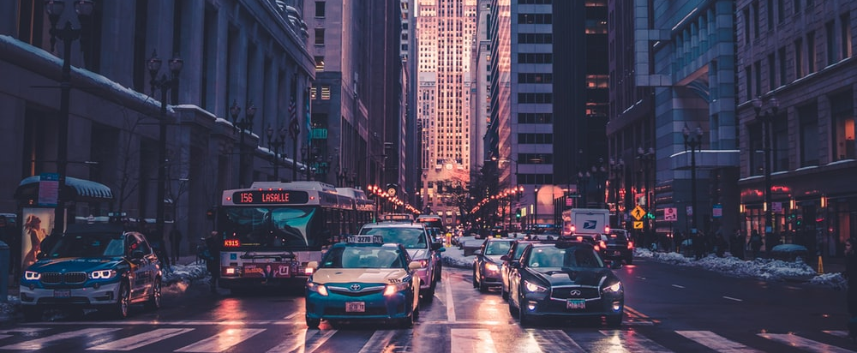
Part X: What have I learnt today? …
What have I learnt today?
I can talk about places in the city; asking and giving directions. For this objective, I practiced prepositions of place, used common structures relating to directions and reviewed the use of ‘there+to be’.
Book II: Linda in Real Life
Centro de Idiomas 2019

